Slide 1

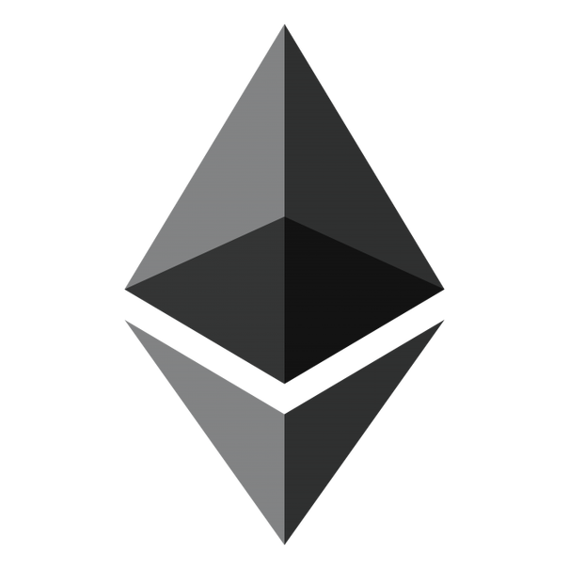
Intro To Ethereum
Matt.Wilhelm@InfernoRed.com
@AddressXception
Github.com/AddressXception/ethereum-nova-code-camp-2018

Slide 2



Northern VA CodeCamp Spring 2018
is sponsored by

Slide 3

What will we learn?
Ethereum Protocol Fundamentals
How smart contracts work
Different Ethereum Networks
Configuring a development environment
Developer tools
Debugging & Testing
Deploying code
Notes:
First we will look at the basics of how ethereum works and examine some key concepts that are critical to development. We have a lot to cover today so I’m going to skip over the more nuanced details; but all of that information can be found online and I’ll point that out on a resources slide at the end. We’re going to talk about how smart contracts work at a high level and gain a basic understanding of what they can be used for. Since ethereum is open source, we’ll look at a few different types of networks and discuss deploying code to private as well as public networks. We’ll set up a development environment look at some of the tooling available & finally debug, test, and deploy some code.

Slide 4
What Is ethereum
Distributed Append-only database
A protocol for transacting with the database
A turing-complete virtual code execution environment
Built-in fault tolerance (Byzantine Generals)
A token to transfer value between users and pay for using the network
All the RAGE!
Notes:
I want to just briefly define what ehtereum is so we are all on the same page.

Slide 5

Why should I Care?
Record of Account
Cryptographically verifiable audit trail
Byzantine fault tolerance – protection against malicious actors
Private chains are well suited
Permissioned Ethereum
https://github.com/jpmorganchase/quorum
Consensus
Settlement & Clearing
Process efficiency between untrusted parties
Public chains are well suited
https://www.coindesk.com/security-settles-ethereum-first-kind-blockchain-transaction/
“in the ethereum bond last year the final cost was reduced from an estimated 40,000 pounds to about 50 pounds”
Notes:
When preparing for this presentation I was discussing with one of my coworkers my approach; and he said, “yes I’m familiar with how it all works; but what I’m missing is why should I care?” That’s when I realized it is difficult to see past all of the hype surrounding blockchain tech.
As with any software project, it’s important to consider the problem domain you are trying to solve before you pick your tools. Today it seems like every startup or company has a blockchain hammer looking for a nail, so it can be difficult to see why this may be a better solution than a traditional client-server model, or some other architecture.
There are probably many use cases I haven’t thought of, but the two main ones are for projects that need to maintain a record of account and projects that need to provide consensus among untrsuted parties.
Ethereum is essentially a highly fault-tolerant distributed database that can execute stored procedures; so it can be a very compelling development platform that can theoretically have lower maintenance costs than a traditional geo-replicated database model.
In a private environment Ether (the cryptocurrency that powers the network) has no real value so transaction and storage costs can rival other implementations such as a traditional replicated relational database. Database throughput is still a concern and is likely the main reason you wouldn’t use a system like this.
Most people agree however that the real value is in the public network where you essentially pay a transaction costs to buy trust. As an example in March a ForEx contract was settled on the public ethereum blockchain as a real-world test to validate the assumptions that blockchain settlement can be cheaper than using 3rd party clearing houses.

Slide 6

What is a smart contract?
“ a set of promises, specified in digital form, including protocols within which the parties perform on these promises…” – Nick Szabo 1996
“Smart contracts are computer protocols intended to facilitate, verify, or enforce the negotiation or performance of a contract.” – Wikipedia
“a collection of code (its functions) and data (its state) that resides at a specific address on the Ethereum blockchain.” – ethdocs.org
Deterministic
Mutable
Verifiable
Notes:
Smart contracts are essentially just code. I like the analogy of a Stored Procedure that anyone can deploy and execute.
The contract portion of the name is a bit misleading because it implies there must be a counterparty but that is not necessarily the case – even if it is one of the primary use cases.
In the case of Ethereum; Smart Contracts are just blocks of code with function inputs and outputs and that mutate state.
When you issue a transaction to a smart contract, the network (a miner) will execute the code with the given inputs and will write the outputs to the blockchain effectively transitioning the state of your app.
This change will propagate to all other nodes in the network and will be verified by everyone essentially proving you code did what it says it does.

Slide 7

Some Examples
Decentralized payment processor - https://omisego.network/
Prediction Market rewards model accuracy - http://www.augur.net/
Permission-less Exchange Protocol - https://0xproject.com/
Cash Loans - https://www.saltlending.com/
Distributed Storage - https://storj.io/
Digital Assets - https://www.cryptokitties.co/
https://etherscan.io/address/0x06012c8cf97bead5deae237070f9587f8e7a266d#code
Notes:
There are a number of interesting projects being built on Ethereum, and maybe more than a few scams too.
Here are a few projects that seem legit and have a chance at succeeding at solving real world problems.
No mention of Ethereum smart contracts would be complete without Talking about Crypto Kitties. For those unfamiliar, crypto kitties are essentially non-divisible digital assets in the form of a game. (DESCRIBE & show website)
Late last year the overwhelming popularity of Crypto-Kitties brought the ethereum network to a standstill and demonstrated the scalability issues of the ethereum virtual machine.
We’ll be looking closely at Crypto Kitties as an example to demonstrate some of the features of the Ethereum platform. Since just about everything in the Ethereum ecosystem is open source, lets take a look at the crypto kitties smart contract.

Slide 8

Crypto Kitties
Source code is available. The developer uploaded this.
Contract ABI (App Binary Interface) defines Public API
Contract Source
Contract – similar to a class or interface
Public field – data field (state variables stored in the EVM)
Function – method or code block similar to other OO languages
Modifier –check a condition prior to execution
Require – basically: if (!condition) throw;
Event – dispatched signals (a means to listen for changes)
ERC721 contract interface
Notes:
The crypto kitties contract is a good starting example to show off a few development concepts.
If we look at it on etherscan you can see the developers uploaded the contract source code. This isn’t required but it does help with visibility.
If the developer didn’t upload the source, the ABI interface must be available. This is a data structure that represents how the outside world can interface with the contract code. It’s essentially the public interface for your contract binary.
So lets look at the contract source briefly.
Looking at the Ownable interface we can see a few ethereum concepts demonstrated.
You’ll notice this contract implements the ERC721 interface. These are just contracts agreed on to define a common set of methods across different contracts. By having a standard API surface other developers can build things assuming that those methods are there.

Slide 9
Solidity
https://solidity.readthedocs.io/en/latest/types.html
Statically Typed Language (c++, c#, Java)
Value Types – Boolean, Integer, Enum, Function, Address
Less than 256 bits
Reference Types – String, Array, Struct, Mapping
Greater than 256 bits
Data location changes depending on context
Storage
memory
Notes:
Like most statically types languages there are value types and reference types.
Value types will always be passed around as values, whereas reference types can be quite complex and large and thus a pointer is passed.
Because reference types can be quite large, care must be given to their data location.
The data location varies by default depending on context built can always be changed by using a function modifier. For instance public contract fields are always located in storage.
The docs are quire good here and I highly recommend reading through them.

Slide 10
Ethereum Virtual Machine
http://www.ethdocs.org/en/latest/
https://solidity.readthedocs.io/en/v0.4.21/introduction-to-smart-contracts.html
Stack-based bytecode language
PUSH1 0 CALLDATALOAD SLOAD NOT PUSH1 9 JUMPI STOP JUMPDEST PUSH1 32 CALLDATALOAD PUSH1 0 CALLDATALOAD SSTORE
Contracts are compiled into a series of OpCodes
Each OpCode has a cost (GAS)
https://github.com/djrtwo/evm-opcode-gas-costs/blob/master/opcode-gas-costs_EIP-150_revision-1e18248_2017-04-12.csv
Gas separates the cost of operations from the price of the ETH token.
GasPrice (The Price in ETH for each unit) - https://ethgasstation.info/
GasLimit (To prevent DDOS attacks each transaction must specify a limit)
https://github.com/ethereum/wiki/wiki/JavaScript-API#web3ethestimategas
Notes:
The ethereum documentation will be your friend. It is fairly complete and will provide an excellent resource for understanding various facets of development.
Basically the EVM uses a stack-based bytecode language and an internal cost reference to associate a cost to every operation. For instance, adding 2 integers costs 3 GAS.
The costs are in the Ethereum yellow paper but this github link extracts them into a CSV for easy reading.
The dev team decided to use GAS as a way to separate the fixed costs of operation from the variable costs of the ETH token.
The prevailing market price can be found on eth gas station.
You can set the price you want to pay based on the market to have your transaction mined.
It important to note that in most cases the gas price and limit are user-facing values that end users can manipulate in most circumstances depending on how they send their transaction to your contracts. We’ll look at this more in a bit.

Slide 11
Accounts & Transactions
https://etherscan.io/address/0x06012c8cf97bead5deae237070f9587f8e7a266d
Two account types:
Externally Own Accounts (User Accounts)
has an ether balance,
can send transactions (ether transfer or trigger contract code),
is controlled by private keys,
has no associated code.
Contract Accounts (“owned” by User Accounts)
has an ether balance,
has associated code
code execution is triggered by transactions or messages (calls) received from other contracts.
Can manipulate its own persistent storage, call other contracts.
Notes:
Now lets take a look at the transaction data structure. This is primarily how users or your front-end application will interact with your contract state.
Lets go back to the cryptokitties contract and look at a random transaction. Notice the transaction may/may not have an ether transfer value depending on the function called.
The gas limit is set when the transaction is created but the actual Tx cost is populated after the code is executed and the block is confirmed. That Tx fee goes to the miner.
Now is a good time to look at the two different types of accounts.
Basically user accounts do not have code whereas contract accounts do have code.
User accounts own contract accounts since each contract account must be deployed by a user account and be mined like any other transaction.

Slide 12
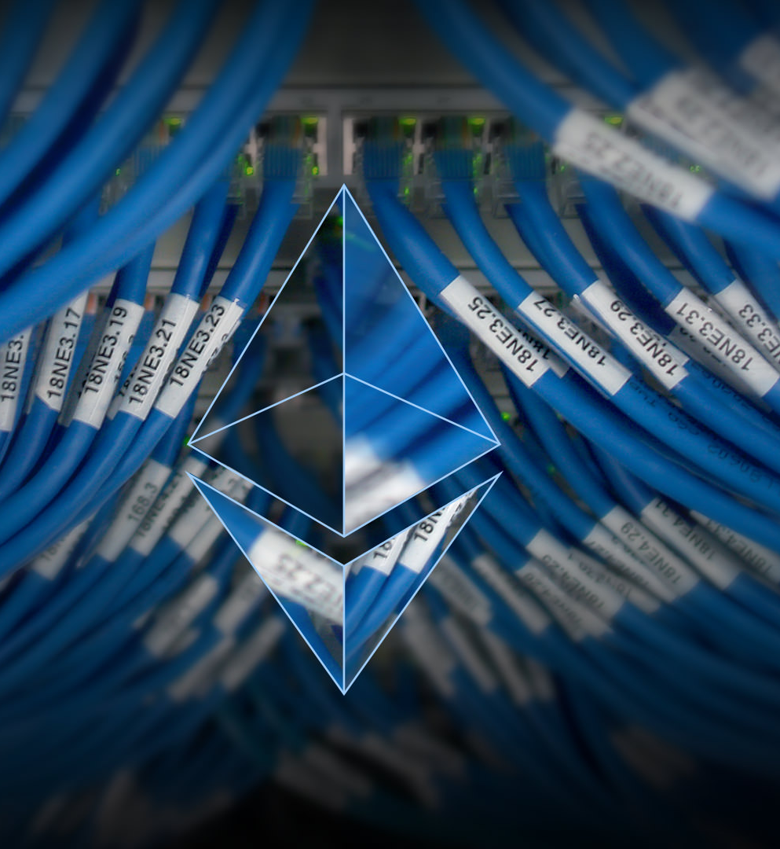
Ethereum Networks
3 ways to develop on Etehreum
Private Networks – localhost, EC2/Azure VM’s, real hardware cluster
Public TestNets – different versions of EVM where ETH has no real world value.
Ropsten – Supports Mining
Rinkeby – No mining (use a faucet to get ETH)
Public MainNet
Notes:
There are essentially 3 types of networks.
Private nets are just private deployments of ethereum. It can be on your local host, or any combination of real and virtual hardware.
Public test nets are test networks maintained by the community to test and debug smart contracts before deploying to the real network .
Because there are real-world financial implications to running on the main net it is always recommended to test against the test networks before deploying your contracts.
Its important to note that whenever you connect to the ethereum network you are connecting through a node.
While the ETH network is decentralized, you are still connecting to it from a single point of failure.
If you connect ot a node that is untrusted you can essentially become the victim of a malicious actor.
In the real world however this isn’t a major concern since the consensus mechanisms in place incentivize nodes to behave according to the rules. It’s just something to consider if your application is privacy-focused

Slide 13
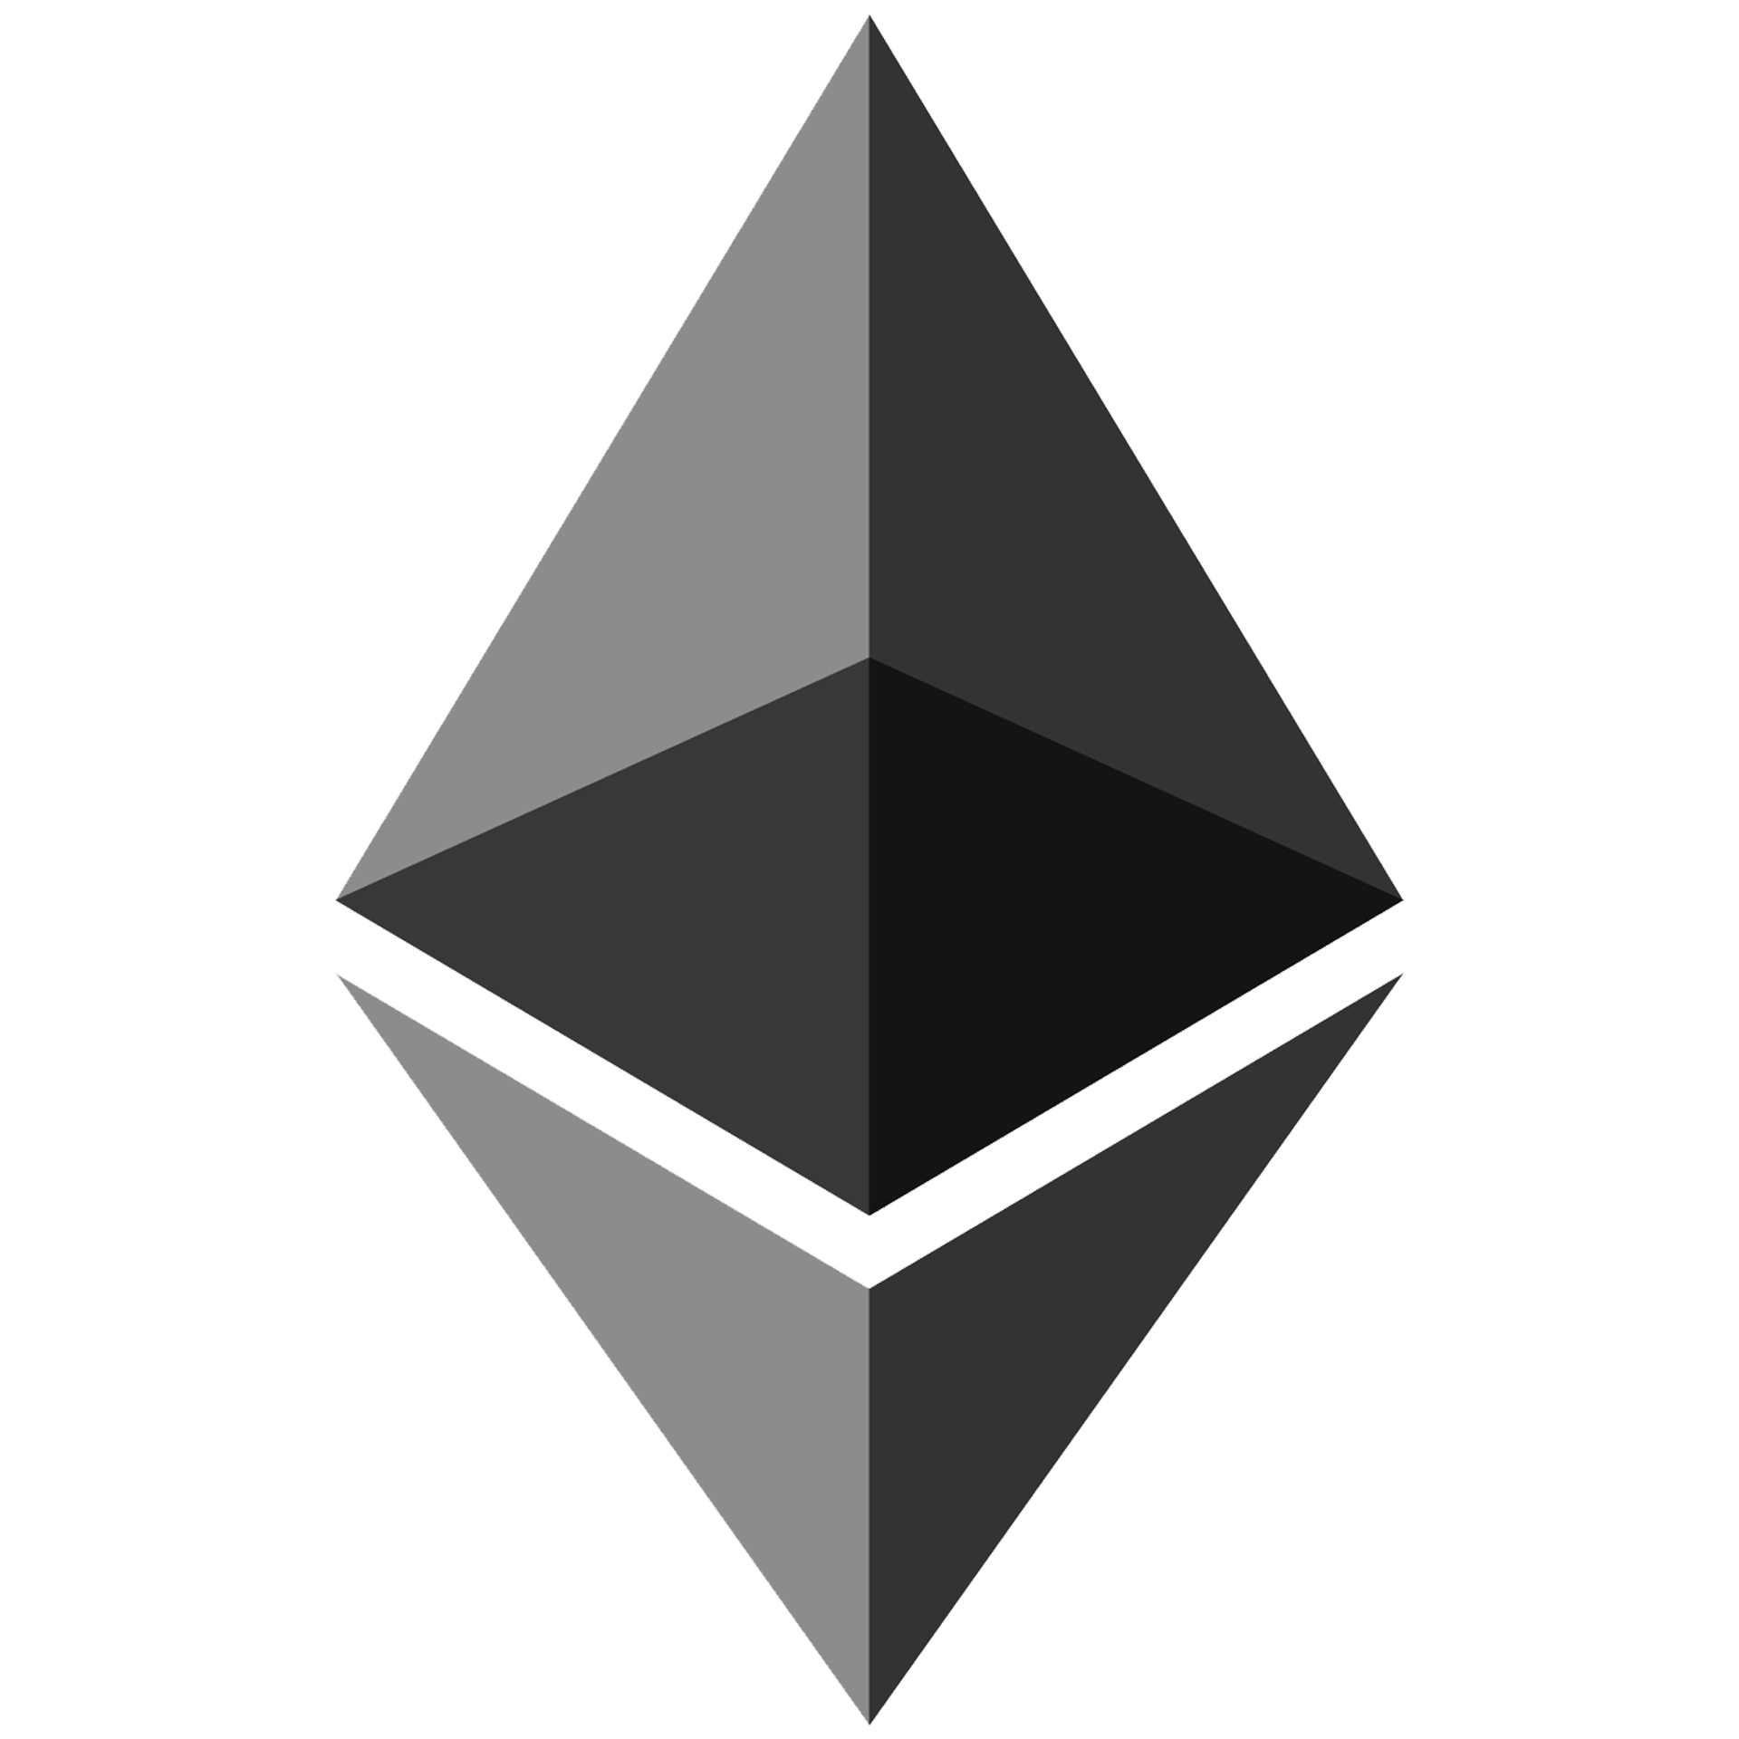
Developer Steps
(optionally) configure your infrastructure
Configure environment
Build & deploy smart contract
Transaction sent to the “0” account on the blockchain.
A new Contract Account is created with an address derived from the sender and the number of outbound transactions
The payload is interpreted as EVM bytecode to set up your contract & execute the constructor function.
Build and deploy front-end
Test Test Test
Notes:
So what happens when we deploy a contract?
We are essentially just transmitting a standard transaction to the network to a specific address (called the 0 address) and sending EVM bytecode that wraps our contract code.
That transaction gets mined like any other and our code is deployed on the EVM to a specific address that is based on the sender address and a “nonce” value derived from the number of outbound transactions we’ve made.

Slide 14

Environment Tl;DR
Install Metamask in Chrome FireFox and Brave. - https://metamask.io
Get some ETH on Rinkeby test net - https://www.rinkeby.io/#faucet
IMPORTANT! CHECK YOUR NETWORK!
I keep completely separate accounts for Mainnet and testnets
http://remix.ethereum.org
Deploy the ballot example
Notes:
So now lets get our devenv setup.
To get going quickly all you need is to install the metamask browser extension. (SHOW META)
We are going to actually deploy a contract to the test net so if you want to participate and follow along, you can install metamask now.
It is critically important to make sure you are connected to the correct network.
You do not want to deploy your test code to the main net until you are certain, and the tools will let you do it without warning.
So now let’s fire up the browser-based solidity compiler and deploy some code to the test network. Once this transaction clears we can execute the functions against the ballot.

Slide 15

Lets Vote!
Which is the best Star Wars Movie that isn’t Empire?
1 – A New Hope
2 – The Last Jedi
3 – Any except the Phantom Menace
Paste your public Ethereum address here:
Paper.dropbox.com/
Create a transaction - https://www.myetherwallet.com/
https://github.com/ethereum/wiki/wiki/Ethereum-Contract-ABI#examples
We need the function abi: 0xb3f98adc
And the input value as a 32-byte word –
0000000000000000000000000000000000000000000000000000000000000001
Lets Vote!
Notes:
Lets fire up myetherwallet. Careful to check the url. There are many many scam sites out there.
Be sure to change the network to rinkeby.
Drop your public ethereum address and I will add everyone to the ballot.
Now you need to generate a transaction. We are going to do this manually this time.
The signature is the method ABI hash, followed by the parameter padded out to 32 bytes (UINT8).

Slide 16

Local Development
Node/NPM
Web3.js – javascript interface for working with Ethereum JSON RPC
Truffle – Full-featured testing and deployment framework
Ganache – encapsulated ethereum local network
Visual Studio Code – code editor
solidity-plugin
Notes:
Sometimes we can’t or don’t want to develop with an internet connection, so lets configure a local environment for development.
I’m working on a Mac but the instructions are similar for a windows machine.
In the interest of time, by environment is already set up; but I will walk through each of the steps to get configured for offline development.

Slide 17
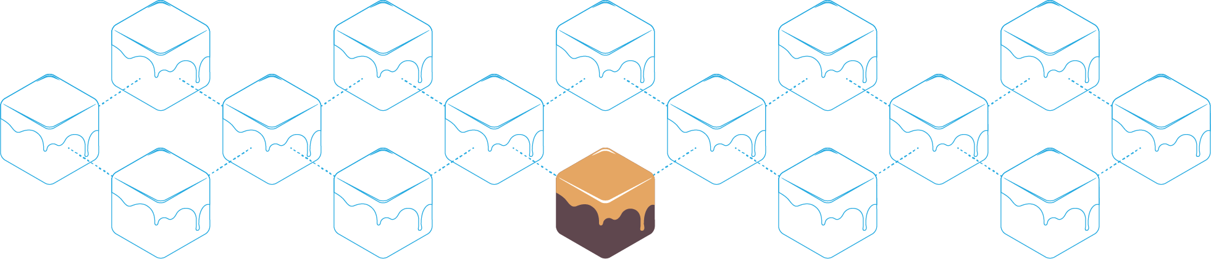
Configuring Metamask and Ganache
https://github.com/trufflesuite/ganache
Settings HostName -> 127.0.0.1:7545
Copy private key(s) to metamask
Send a test transaction
We’re offline!
Notes:
So now we want to set up our private block chain to be addressable from metamask.
So now we have a local block chain running on our local machine.
Lets send a couple test transactions and prove that we are offline by turning off wifi.

Slide 18

File > New Project
Mkdir eth-vote
Npm install truffle (I also install it globally)
Truffle init
Lets copy over the ballot code now.
Create a 2_deploy_contracts.js file
Truffle.js add our test network
Truffle migrate
Check the deployed contract
Notes:
Ok so these are the basic steps to set up a new project.
Once the contract is migrated onto the blockchain we can execute the same steps that we did against the rinkeby test net.

Slide 19
Web3.js
https://github.com/ethereum/wiki/wiki/JavaScript-API
Truffle console
Assign vars to the accounts:
Account0 = web3.eth.accounts[0], 80, 93
Associate the instance and assign voters
Ballot.deployed().then(instance => {ballot = instance})
ballot.giveRightToVote(account80)
ballot.giveRightToVote(account93)
Metamask -> send transactions like we did before
ballot.winningProposal()
Notes:
So now lets fire up the truffle developer console and configure a basic state.
Assign vars to the accounts to make it easier to type, then assign the contract to a variable as well.
Now we can invoke functions on the contract using the javascript api surface.
Under the hood web3 will convert our high-level calls into the TX data we need.

Slide 20

Testing
Can test in solidity or javacsript
Solidity
Should not extend base contracts
All test contract names must start with “Test” (capital T)
All function test names must start with “test” (lowercase t)
Javascript
Truffle uses mocha
Truffle test
Ganache – see our tests being executed
Notes:
I have two examples here that show executing the same tests in solidity and javascript. Lets go look at our constructor

Slide 21

fn(), fn.call(), fn.sendTransatction()
fn() and fn.sendTransaction() are the same
Executes a tx on the blockchain
Can read and write state
Returns an object with tx id
Costs gas, must be mined
Fn.call()
Can only read state
Executes immediately (does not need mined)
Exposes a return value
Fn.call({from: accounts[1]})
Notes:
A note about function calls. When testing there are a couple ways to call functions.
Calling a function directly executes it on the blockchain while calling the “call” will simply return a value from the contact state.
Additionally, we can pass in an object at the end that represents modifications to the transaction.
This allows us to mock different senders or gas limits, etc.

Slide 22
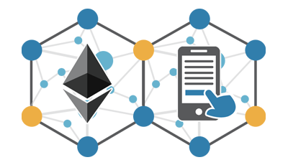
Improve our contract
Default empty payable
A means to recover funds if people send balance to your contract address
selfDestruct
onlyOwner modifier
Fire Event
Notes:
So now lets look at improving our contract.
This is a basic example but there are a few things we want to do to make sure we don’t shoot ourselves in the foot.
First, we want to make sure that the contract has a self-destruct method that only the owner can call.
If for whatever reason you find an exploit in your contract, the owner can kill the contract.
The contract is never really removed from the blockchain, but its state is wiped out and code can no longer be executed against it.

Slide 23

Deploying to other nets
Download and sync the rinkeby netowrk
https://www.rinkeby.io/#geth
Add another network in truffle.js
Truffle migrate –network development
Notes:
Deploying our code to the rinkeby test net can be done from the command line too,
we just need to create another network and tell truffle about it.
You’ll need to set up and configure the Go Ethereum client (or connect to a known one) in order to broadcast transactions to the network

Slide 24
Resources
Communicating with other Dapps - https://github.com/ethereum/wiki/wiki/Standardized_Contract_APIs
Useful DAPP Patterns - https://github.com/ethereum/wiki/wiki/Useful-%C3%90app-Patterns
Contract Best Practices https://consensys.github.io/smart-contract-best-practices
Official Documentation - https://github.com/ethereum/wiki/wiki
Gitcoin - https://gitcoin.co/

Slide 25
Resources (continued)
Crypto Zombies – https://cryptozombies.io
Truffle Tutorials – http://truffleframework.com/tutorials/
Eth Ontology - http://ethon.consensys.net/
The DAO Hack - http://truffleframework.com/tutorials/chain-forking-exploiting-the-dao
Drizzle - http://truffleframework.com/docs/drizzle/getting-started
Open Zeppelin - https://openzeppelin.org/
Gluon (non-tivial example) - https://github.com/gluon-project/gluon-rxp
Security analysis - https://github.com/ConsenSys/mythril

